Slide 1



State behaviour

Slide 2
Today
Know how to read/write state diagrams
Show the relation between code and state diagram
Use events & actions in a state-diagram
Testing and mocking

Slide 3
What is a state?
A state models a situation during which some (usually implicit) invariant condition holds. The invariant may represent a static situation such as an object waiting for some external event to occur. However, it can also model dynamic conditions such as the process of performing some behavior (i.e., the model element under consideration enters the state when the behavior commences and leaves it as soon as the behavior is completed).
Invariant is a condition that is supposed to be true all the time (except for brief, well-defined intervals)
Notes:
State charts are mostly used in reactive systems (systems that wait for and react to asynchronous input changes)

Slide 4
Concept
Notes:
A transition almost always has an event (notable exception: transition from the Initial Pseudo State)
You often don’t need guards, but if you do: this is the notation
Your state diagram should have actions (either internal notation or external notation, see further in the presentation), if it doesn’t have actions your state machine doesn’t actually do anything!
Lots of state diagrams don’t have a pseudo end state, you only need it if your state machine ends (obviously not in the main state machine of a 24/7 system)

Slide 5
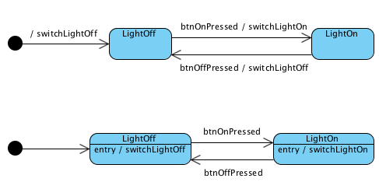
Example: light switch
vs:

Slide 6
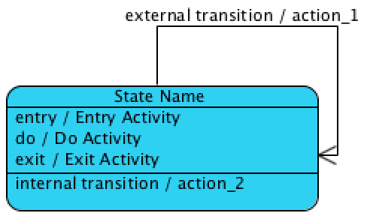
Internal notation
entry is like a state constructor
exit is like a state destructor
do is the action that is started when this state is entered
should run in background (e.g. separate thread)
is relatively hard to program in plain C++
don’t use for now unless absolutely needed

Slide 7
Internal vs external transition
Do mind the difference!
Current state is “State Name”
Event “external transition” occurs:
Do Activity is stopped
Exit Activity is executed
action_1 is executed
Entry Activity is executed
Do Activity is started
Event “internal transition” occurs:
action_2 is executed

Slide 8
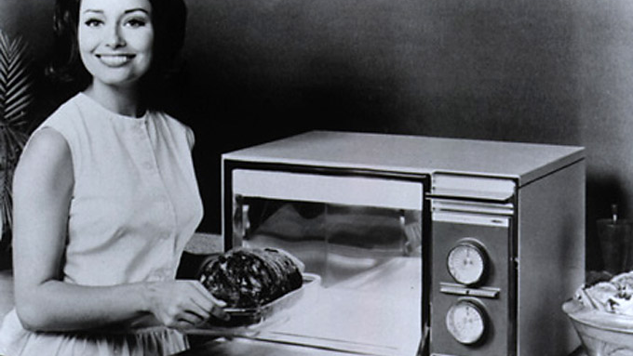
Case study: microwave

Slide 9
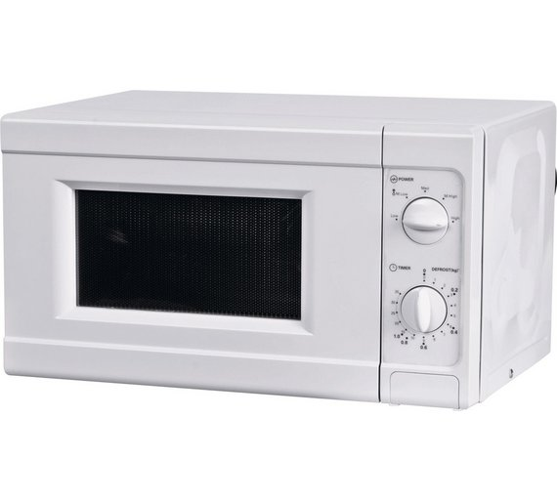
External interface
Power dial
Mechanical clock dial
Door open button
What events do we have?
assume you get a ‘start’ and ‘time up’ event from the mechanical clock
what else?

Slide 10
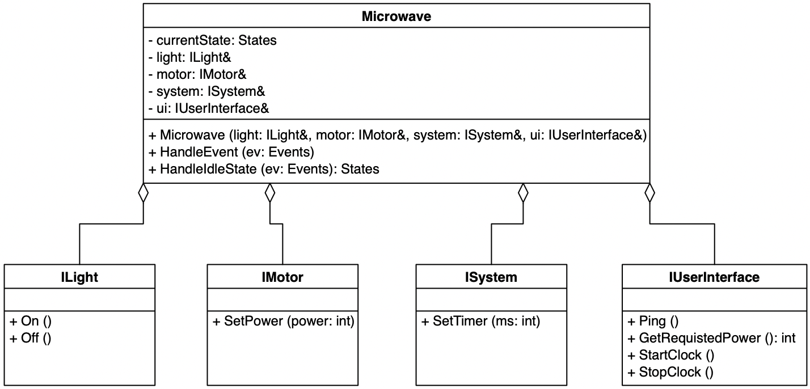
HAL + State class

Slide 11
Responsibilities
Microwave class: implements state behaviour
Constructor: remembers implementations for required interfaces and sets initial state
HandleEvent: runs the state machine, is called each time an event occurs
HandleIdleState: is ran by HandleEvent when IdleState is acive, it returns the next state (or IdleState if no state change occurs) Note: after making the state diagram, other Handle…State methods are added
ILight interface
On: switches the light in the microwave on
Off: switches the light in the microwave off
IMotor interface
SetPower(power: int): sets the microwave engine to the required power, 0 switches the engine off
ISystem interface*
SetTimer(ms: int): enables a timer for ms miliseconds, when the timer fires the TIME_UP event is given
IUserInterface interface
Ping(): gives a subtle beeping sound
GetRequestedPower(): int: returns the power dialed in by the user
StartClock: enables the time dial to slowly turn back to 0
StopClock: stops the time dial
*) ISystem is not necessarily needed. It’s there if you want to do things like:
when leaving the door opened for 2 minutes, the light switches off

Slide 12
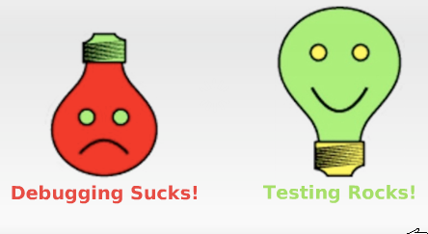
Intermezzo... Testing and mocks

Slide 13

Unit testing – Intro to Google Test
Test a class or function by making assertions about its behaviour
When an assertion fails, Google Test prints an error message with source filename and line number
Assert vs Expect: fatal vs non-fatal
ASSERT_TRUE, _FALSE (condition is true or false)
ASSERT_EQ, _NE, _LT, _LE, _GT, _GE (equal, non-equal, lower than, lower-equals, greater than, greater-equals)
ASSERT_STREQ, etc (various c-string equals, non-equals and variants that ignore case. For string objects, use ASSERT_EQ et al)
(See: Google Test Primer)

Slide 14
Unit testing – Intro to Google Test
You can use Google Test in 2 ways
individual tests (defined by TEST macro)
Ideal when you don’t need test data
i.e. parameter tests
Using a test class (defined by TEST_F macro)
Ideal for when you have generic test data
i.e. a standard instantiation of a class, filled with test data
Each test creates a new instance of your class, thus each test starts with fresh data
A test file can contain multiple test classes and individual tests

Slide 15
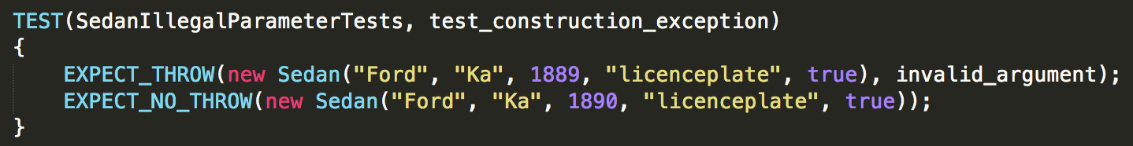
Unit testing – Google TEST example

Slide 16
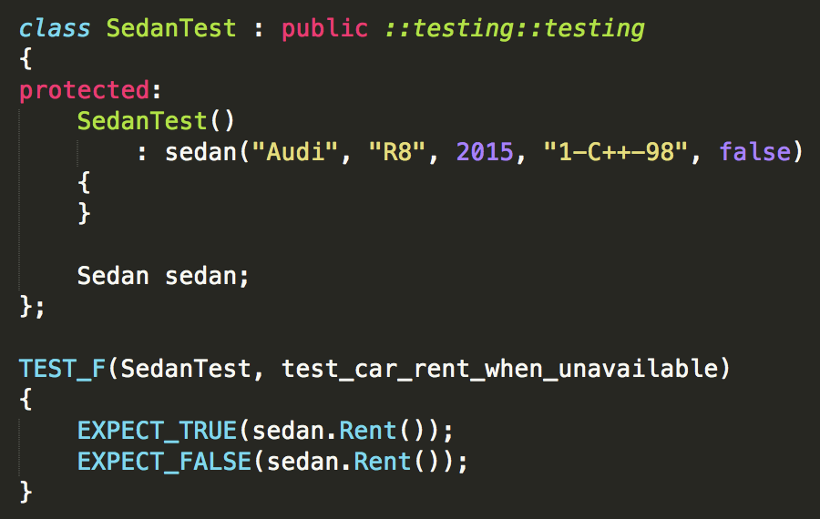
Unit testing – Google TEST_F example
protected keyword:
see next slides!
Every SedanTest has an Audi R8 Sedan instance and a testPtr that points to it.

Slide 17
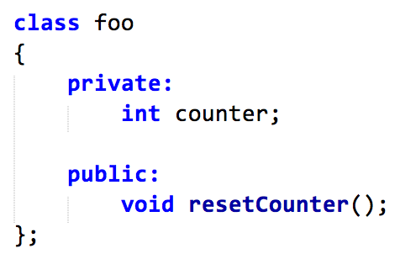
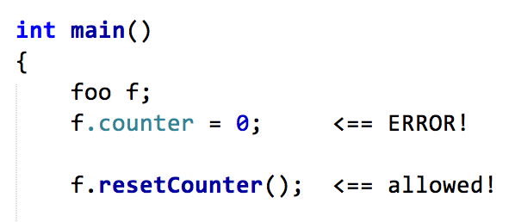
Intermezzo 2: protected keyword
A class can have private and public parts:
private: access limited to the class itself
public: any code can access the member by its name

Slide 18
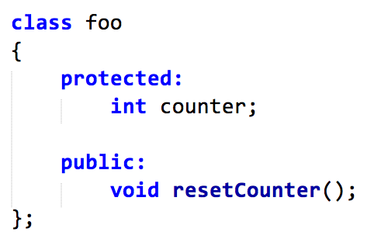
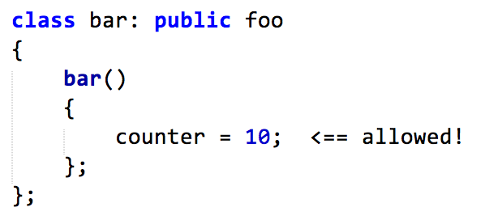
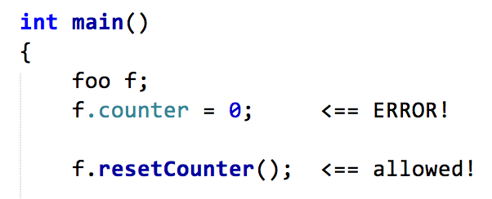
Intermezzo 2: protected keyword
A class can also have protected parts
protected: access limited to class itself and all subclasses

Slide 19
Intermezzo 2: to protect or not to protect
In real life you’ll hardly ever use the protected keyword
In lots of cases you have a design problem if you need it
The reason Google Test depends on protected is because for each TEST_F test:
A new class is created that inherits from your test class

Slide 20
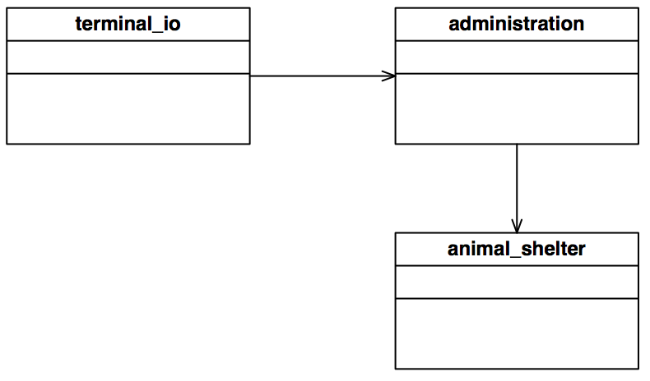
Unit testing – Limits
Flashback: ES2
How do you test administration?
Remember: tests should be independent! (meaning: you want to test administration without requiring animal_shelter - consider WHY!)

Slide 21
Introduction: mocks
A mock class is a fake class
one that is easy to make
one that ‘magically’ implements the required interface
one that gives you control on return value and parameters

Slide 22
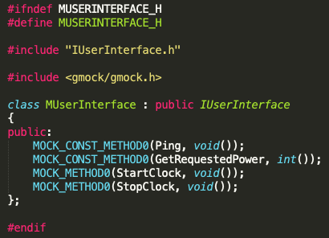
Mocks: easy to make
const: this is a const function
return type: int
0: it’s a method without parameters
return type: void

Slide 23
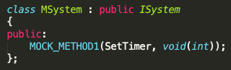
Mocks: easy to make
The parameter type (comma separated list if you have more than one)
1: one parameter,
type: int

Slide 24
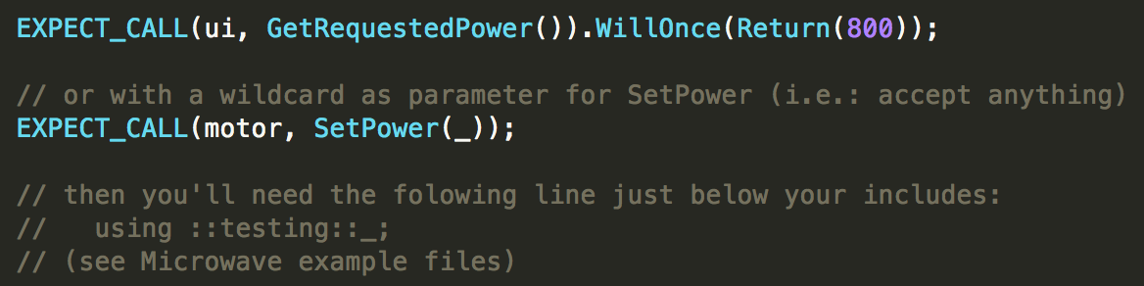
Mocks: control

Slide 25
Ok, so we are implementing this

Slide 26
Responsibilities
Microwave class: implements state behaviour
Constructor: remembers implementations for required interfaces and sets initial state
HandleEvent: runs the state machine, is called each time an event occurs
HandleIdleState: is ran by HandleEvent when IdleState is acive, it returns the next state (or IdleState if no state change occurs) Note: after making the state diagram, other Handle…State methods are added
ILight interface
On: switches the light in the microwave on
Off: switches the light in the microwave off
IMotor interface
SetPower(power: int): sets the microwave engine to the required power, 0 switches the engine off
ISystem interface*
SetTimer(ms: int): enables a timer for ms miliseconds, when the timer fires the TIME_UP event is given
IUserInterface interface
Ping(): gives a subtle beeping sound
GetRequestedPower(): int: returns the power dialed in by the user
StartClock: enables the time dial to slowly turn back to 0
StopClock: stops the time dial
*) ISystem is not necessarily needed. It’s there if you want to do things like:
when leaving the door opened for 2 minutes, the light switches off

Slide 27
Construction of Microwave object
Normal situation:
Light light(...);
Motor motor(...);
System system(...);
UserInterface ui(...);
Microwave mw(light, motor, system, ui)
Test situation:
MLight light(...);
MMotor motor(...);
MSystem system(...);
MUserInterface ui(...);
Microwave mw(light, motor, system, ui)
A mock is an automated, fake implementation of an interface
(the ’M’ prefix indicates it’s a mock: MLight implements ILight, etc.)

Slide 28
Let’s do it!
Live state demo on white board
Implement the rest of the state machine and including tests

Slide 29

Reading:
Chapter 5

